Slide 1

Twitter Sentiment Analysis
B.Tech Project Final Evaluation, VIIIth Sem
Presented by:-
Aditi Patial (2019636301)
Nitesh Mishra (2019006598)
Mousam Panthi(2019002292)
Under the supervision of:-
Dr. Jabir Ali
DEPARTMENT OF COMPUTER SCIENCE & ENGINEERING
SCHOOL OF ENGINEERING AND TECHNOLOGY

Slide 2
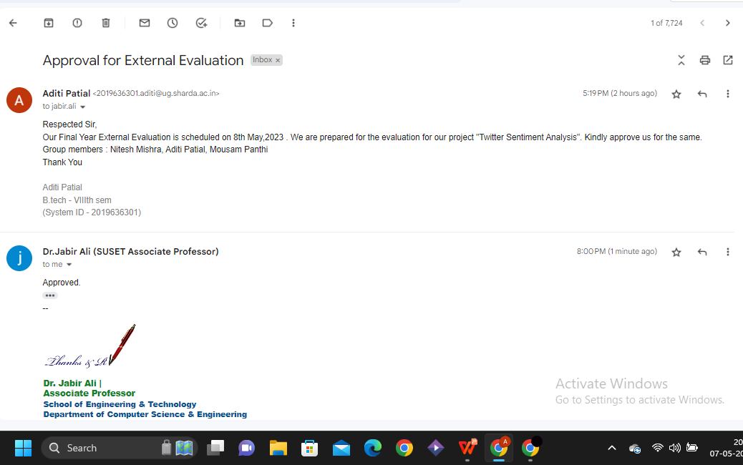
APPROVAL FROM THE GUIDE

Slide 3
TABLE OF CONTENTS
Introduction to the project
Motivation for the project
Problem Statements/Objectives of the Project
Project Planning
Methodology and Implementation
Literature Survey
Classifiers Used
Experiments
Results Produced
Proof of the Outcome
References

Slide 4
INTRODUCTION
Twitter is a social media platform where users can post and interact via messages commonly known as “tweets”. The registered users can like, comment, retweet posts or post on their own while the unregistered users only have access to read the public tweets. These tweets sometimes project emotions in the form of a single word or large sentences.While Twitter provides a public forum for people to share their ideas, opinions, and discussions, the sheer volume of posts, comments, and messages made there makes it nearly impossible to monitor what to make of them. Furthermore, due to the diversity in backgrounds, cultures and beliefs, many people are likely to use aggressive and hateful language while conversing with people with different backgrounds.
Training a model effectively and getting accurate results is challenging as it is difficult to classify tweets into a specific sentiment category. Reasons behind such challenges are as follows:
1) Various language ancestries : Various individuals from various cultures tweet using some words with a cultural background, such as advertising, slang, etc.
2) Character block-size restrictions : The amount of information has to be provided in 280 characters which limits the content that can be represented.
3) Use of hashtags : Twitter offers hashtags to mention events and emotions, which needs to be processed separately from the actual word-centred tweets.

Slide 5
MOTIVATION FOR THE PROJECT
Business Insights: Companies often want to understand the sentiment of their customers towards their brand, products, or services. Twitter sentiment analysis can help them gain valuable insights into customer opinions and emotions, allowing them to make data-driven decisions for their business.
Social Media Monitoring: Twitter sentiment analysis can also be used for monitoring social media activities, such as tracking trends, identifying influencers, and measuring the impact of marketing campaigns. It can help organizations to stay up-to-date with what's being said about their brand or industry in real-time.
Customer Service: Twitter sentiment analysis can also be used for customer service purposes. By analyzing tweets from customers, businesses can quickly identify and respond to complaints, issues, or feedback, improving customer satisfaction.

Slide 6
PROBLEM STATEMENT
Twitter is a popular social networking website where members create and interact with messages known as “tweets”. This serves as a mean for individuals to express their thoughts or feelings about different subjects. Various different parties such as consumers and marketers have done sentiment analysis on such tweets to gather insights into products or to conduct market analysis. Furthermore, with the recent advancements in machine learning algorithms, we are able improve the accuracy of our sentiment analysis predictions.
We will attempt to conduct sentiment analysis on “tweets” using various different machine learning algorithms and then combine them to make a hybrid model to increase the accuracy. We attempt to classify the polarity of the tweet where it is either positive or negative. If the tweet has both positive and negative elements, the more dominant sentiment should be picked as the final label.

Slide 7
PROJECT PLANNING
Objective : We are working on increasing the accuracy of an algorithm that will imply the sentiments of the tweets that we feed to the model.
Understanding the theory and intuition behind Twitter Sentiment Analysis and various Classifiers in Machine Learning.
Apply python libraries to import, pre-process and visualize the tweets.
Perform data augmentation to improve model generalization capability.
Build various machine learning model based on sentiment analysis.
Compile and fit the models to training data.
Analyzing accuracies from the outcomes of the models to identify the most accurate algorithm for sentiment analysis.
Design Tools used : -
Python, Jupiter IDE, Numpy
Machine Learning Algorithms like Naive Bayes, SVM, Random Forest,XG Boost etc..

Slide 8
METHODOLOGY AND IMPLEMENTATION
Methods of Sentiment Analysis :
Data Collection
Consumers usually express their sentiments on public forums like the blogs, discussion boards, product reviews as well as on their private logs – Social network sites like Facebook and Twitter. Opinions and feelings are expressed in different way, with different vocabulary, context of writing, usage of short forms and slang, making the data huge and disorganized. Manual analysis of sentiment data is virtually impossible. Therefore, special programming languages like ‘R’ are used to process and analyze the data.
Pre-Processing
It is nothing but filtering the extracted data before analysis. It includes identifying and eliminating non-textual content and content that is irrelevant to the area of study from the data.

Slide 9
Data Analysis
At this stage, each sentence of the review and opinion is examined for subjectivity. Sentences with subjective expressions are retained and that which conveys objective expressions are discarded. Sentiment analysis is done at different levels using common computational techniques like Unigrams, lemmas, negation and so on.
Data Visualization
The main idea of sentiment analysis is to convert unstructured text into meaningful information. After the completion of analysis, the text results are displayed on graphs like pie chart, bar chart and line graphs.

Slide 10
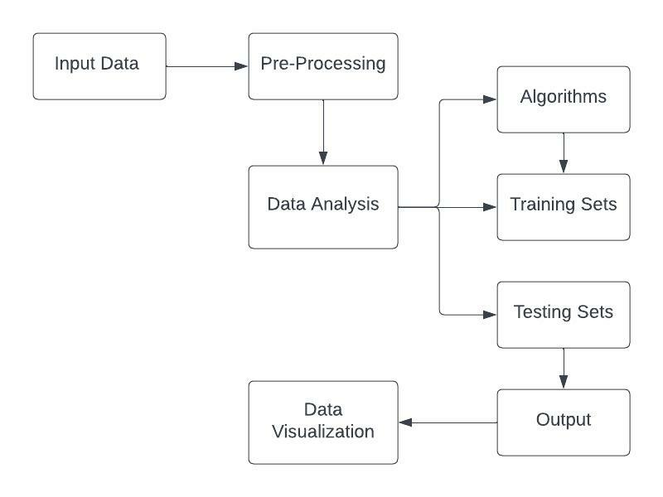

Slide 11
LITERATURE SURVEY
Sentiment analysis provides a great opportunity to evaluate the general opinion of the public or a particular subset of the same regarding different products, services, current affairs and circumstances. This becomes all the more helpful and significant in this age of social media where regulations have decreased greatly.
From the existing studies carried out in the field of twitter sentiment analysis, we can come to the conclusion that the approaches can be broadly divided into two methods. While the Lexicon based approach ascertains the sentiment of a given phrase by evaluating it against the pre-arranged lexicons and their sentiment inclination like in SentiWordNet , the supervised approach is pretty much dependent on the training of classifiers. Supervised method includes and not limited to varying amalgams of features like word N-grams, tweet related meta information like hashtags emoticons etc, and parts of speech tags.
In relation to these studies, it has been observed that a combination of algorithms or hybrid algorithms are stated to account for much better classification results. In paper a combination of deep learning and machine learning is proposed for better classification of sentiments. They have also demonstrated the said method and its efficacy on Chinese and Turkish language datasets.

Slide 12
Deep learning approaches have now been ingrained in machine learning. Image and voice processing tasks have been exceptionally successful with the help of the same, so much so that the said approaches have started to overtake the more conventional and linear methods of natural language processing.
In paper , the authors have suggested a convolution neural network architecture consisting of multiple convolution layers which will put forward as inputs low- dimensional, dense and latent word vectors. They have utilised dynamic CNN for classifying sentiments on twitter and movie reviews. Through experimentation, it appears that dynamic CNN are superior to those based on unigram and bigram models.
In paper, the researchers stressed the importance of pre-processing and concluded that it led to a notable decrease in the initial feature space. They also established that the vocabulary size was cut by up to 62% with the help of pre-processing. Similarly in paper, the authors analysed the significance of text pre-processing in sentiment analysis of movie reviews. The results proved that a remarkable increase in accuracy can be achieved in classification of sentiments by utilising appropriate features and representation after pre-processing.

Slide 13
Hate speech has also become rather evident with the current popularity of social media platforms where people can just spew hate while remaining anonymous. The authors in Gitari et al. utilised grammatical patterns and semantic features for classifying the sentiments in a test set. They created the test sites by deriving sentences from a few of the major ‘‘hate sites’’ in the US. After collecting these sentences, they divided and labelled them into three separate groups: ‘‘strongly hateful (SH)’’, ‘‘weakly hateful (WH)’’, and ‘‘non-hateful (NH)’’. With this approach, they managed to achieve an F1-score equal to 65.12%.
In paper , the writers have proposed an approach to detect hate speech on twitter. This approach includes the classification of tweets into three groups namely Clean, Offensive and Hateful. Then they utilise machine learning to perform the classification by deriving features from the tweets and referring them against the training set. They reached an accuracy equal to 78.4% for the same which then increased to 87.4% for binary classification of tweets into offensive and non-Offensive.

Slide 14
CLASSIFIERS USED
Baseline
Naive Bayes
Maximum Entropy
Decision Tree
Random Forest
XGBoost
SVM
MLP
LSTM
CNN
Ensemble

Slide 15
BASELINE
A baseline model is essentially a simple model that acts as a reference in a machine learning project. Its main function is to contextualize the results of trained models. Baseline models usually lack complexity and may have little predictive power.
NAIVE BAYES
The Naïve Bayes classifier is a supervised machine learning algorithm, which is used for classification tasks, like text classification. It is also part of a family of generative learning algorithms, meaning that it seeks to model the distribution of inputs of a given class or category.
MAXIMUM ENTROPY
The Max Entropy classifier is a probabilistic classifier which belongs to the class of exponential models. Unlike the Naive Bayes classifier that we discussed in the previous article, the Max Entropy does not assume that the features are conditionally independent of each other.

Slide 16
DECISION TREE
DecisionTreeClassifier is a class capable of performing multi-class classification on a dataset. In case that there are multiple classes with the same and highest probability, the classifier will predict the class with the lowest index amongst those classes.
RANDOM FOREST
Random forest is a Supervised Machine Learning Algorithm that is used widely in Classification and Regression problems. It builds decision trees on different samples and takes their majority vote for classification and average in case of regression.
XGBOOST
XGBoost is an optimized distributed gradient boosting library designed to be highly efficient, flexible and portable. It implements Machine Learning algorithms under the Gradient Boosting framework. It provides a parallel tree boosting to solve many data science problems in a fast and accurate way.

Slide 17
SVM
Support vector machines (SVMs) are particular linear classifiers which are based on the margin maximization principle. They perform structural risk minimization, which improves the complexity of the classifier with the aim of achieving excellent generalization performance.
MLP
MLPClassifier stands for Multi-layer Perceptron classifier which in the name itself connects to a Neural Network. Unlike other classification algorithms such as Support Vectors or Naive Bayes Classifier, MLPClassifier relies on an underlying Neural Network to perform the task of classification.
LSTM
LSTM stands for Long-Short Term Memory. LSTM is a type of recurrent neural network but is better than traditional recurrent neural networks in terms of memory. Having a good hold over memorizing certain patterns LSTMs perform fairly better.

Slide 18
CNN
The Convolutional Neural Network (CNN or ConvNet) is a subtype of Neural Networks that is mainly used for applications in image and speech recognition. Its built-in convolutional layer reduces the high dimensionality of images without losing its information.
ENSEMBLE
Ensemble learning is a way of generating various base classifiers from which a new classifier is derived which performs better than any constituent classifier . These base classifiers may differ in the algorithm used, hyperparameters, representation or the training set.

Slide 19
EXPERIMENTS
Baseline
This method produces a result of 63.48%, serving as a baseline for our more complex classification models.
Naive Bayes
When both unigrams and bigrams were employed, Naive Bayes achieved an accuracy of 79.68% in terms of validation.
Maximum Entropy
Using either frequency or presence features yielded almost identical accuracies, but combining unigrams and bigrams slightly enhanced performance, achieving the highest accuracy of 81.52%.

Slide 20
Decision Tree
Adding bigrams to unigrams did not result in any noticeable enhancements. We achieved a maximum accuracy of 68.1% using decision trees.
XGBOOST
We experimented with different features and found that the presence feature with both unigrams and bigrams was the most effective configuration, giving us the highest accuracy of 78.72.
Random Forest
While the increase in accuracy was not significant, the model performed slightly better when we used presence features instead of frequency features. It produced an accuracy of 77.21%.
SVM
The best result was achieved using frequency and Unigram + Bigram, which yielded an accuracy of 81.9%.

Slide 21
Multi-layer Perceptron
For training the model, we employed a sparse vector representation of tweets and discovered that incorporating bigram features had a significant impact on the accuracy of the model i.e 81.7%.
Convolutional Neural Network
We tested 4 different CNN designs.The 4-CNNmodel outperformed the previous CNN models with one, two, and three convolutional layers and achieved a result of 83.34.
Recurrent Neural Network
We utilised neural networks that had LSTM layers. The dense vector representations for the models were trained using the top 20,000 most frequently used words from the training data.The outcomes of the diverse LSTM models that were tested, and the best accuracy achieved among these models was 83.0%.

Slide 22
RESULTS PRODUCED
The provided tweets were a mixture of words, emoticons, URLs, hashtags, user mentions, and symbols. Before training we pre-process the tweets to make it suitable for feeding into models.
We implemented several machine learning algorithms like Naive Bayes, Maximum Entropy, Decision Tree, Random Forest, XGBoost, SVM, Multi-Layer Perceptron, Recurrent Neural networks and Convolutional Neural Networks to classify the polarity of the tweet. We used two types of features namely unigrams and bigrams for classification and observed that augmenting the feature vector with bigrams improved the accuracy.
Once the feature has been extracted it is represented as either a sparse vector or a dense vector. It has been observed that presence in the sparse vector representation recorded a better performance than frequency. Neural methods performed better than other classifiers in general.

Slide 23
Algorithms | Presence |  | Frequency
 | Unigram | Unigrams+Bigrams | Unigrams | Unigrams+Bigrams
Naive Bayes | 78.16 | 79.68 | 77.52 | 79.38
Max Entropy | 79.96 | 81.52 | 79.7 | 81.5
Decision Tree | 68.1 | 68.01 | 67.82 | 67.78
Random Forest | 76.54 | 77.21 | 76.16 | 77.14
XGBoost | 77.56 | 78.72 | 77.42 | 78.32
SVM | 79.54 | 81.11 | 79.83 | 81.9
MLP | 80.1 | 81.7 | 80.15 | 81.35

Slide 24
Our best LSTM model achieved an accuracy of 83.0% while the best CNN model achieved 83.34%. The model which used features from our best CNN model and classified using SVM performed slightly better than only CNN. We finally used an ensemble method taking a majority vote over the predictions of 5 of our best models achieving an accuracy of 83.58%.

Slide 25
Model | Accuracy
LSTM_NN | 83.00
4-Conv-NN | 83.34
4-Conv-NN features + SVM | 83.39
4-Conv-NN with max_length = 20 | 82.85
3-Conv-NN | 82.95
Majority Vote Ensemble | 83.58

Slide 26
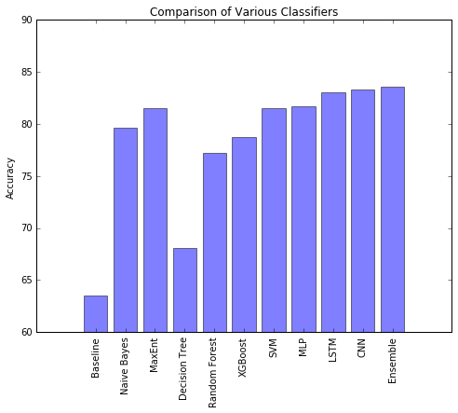

Slide 27
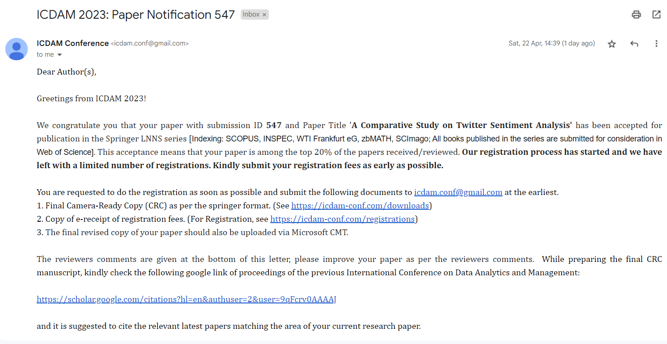
7th Semester Outcome
Paper for the said project has been accepted in 4th International Conference on Data Analytics & Management (ICDAM-2023) ICDAM-2023 Theme: Data Analytics with Computer Networks Organized By: London Metropolitan University, London, UK
Paper Title: "A Comparative Study on Twitter Sentiment Analysis"
Authors: Nitesh Mishra, Mousam Panthi, Aditi Patial, Dr. Jabir Ali

Slide 28
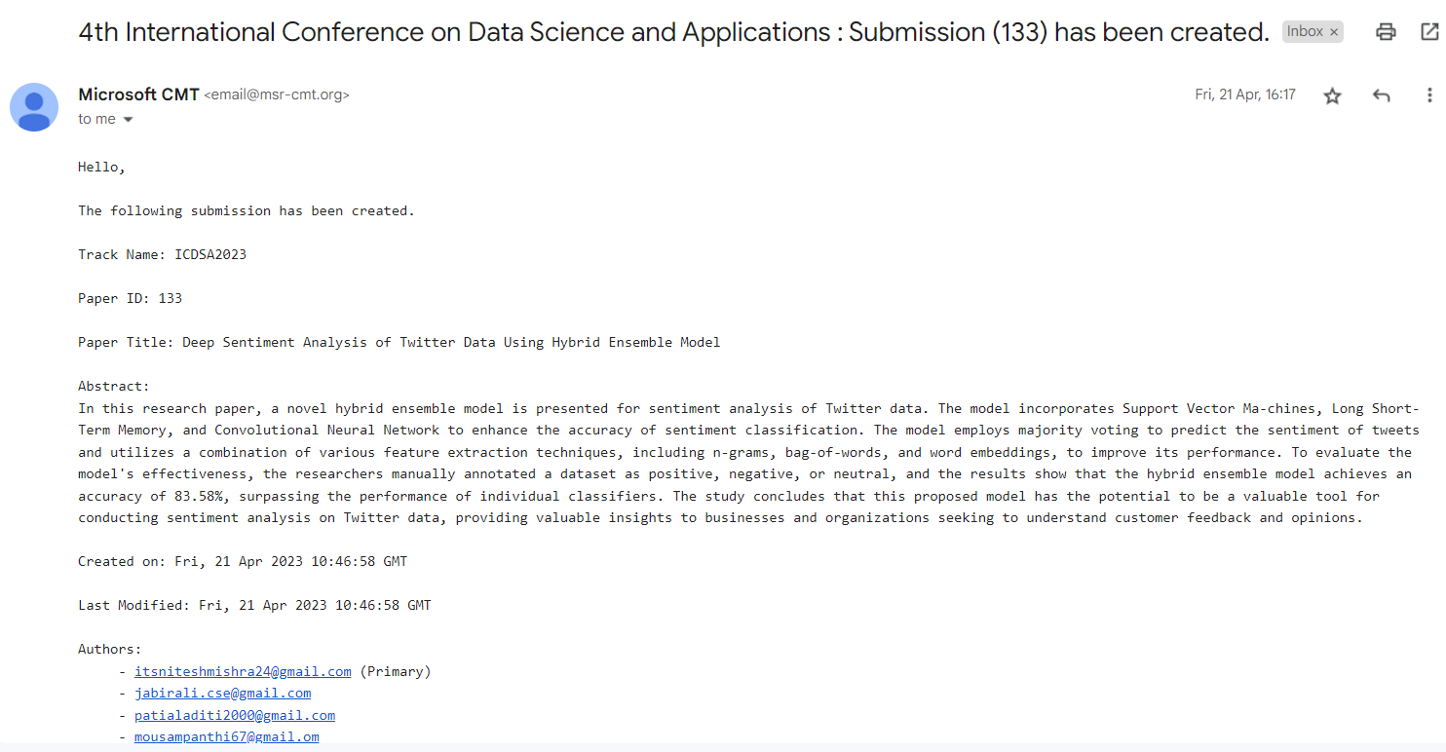
8th Semester Outcome
Research Paper for the said project has been communicated at “4th International Conference on Data Science and Applications (ICDSA 2023) Organised by Malaviya National Institute of Technology Jaipur, India”.
Paper Title: Deep Sentiment Analysis of Twitter Data Using Hybrid Ensemble Model
Authors: Nitesh Mishra, Mousam Panthi, Aditi Patial, Dr. Jabir Ali

Slide 29
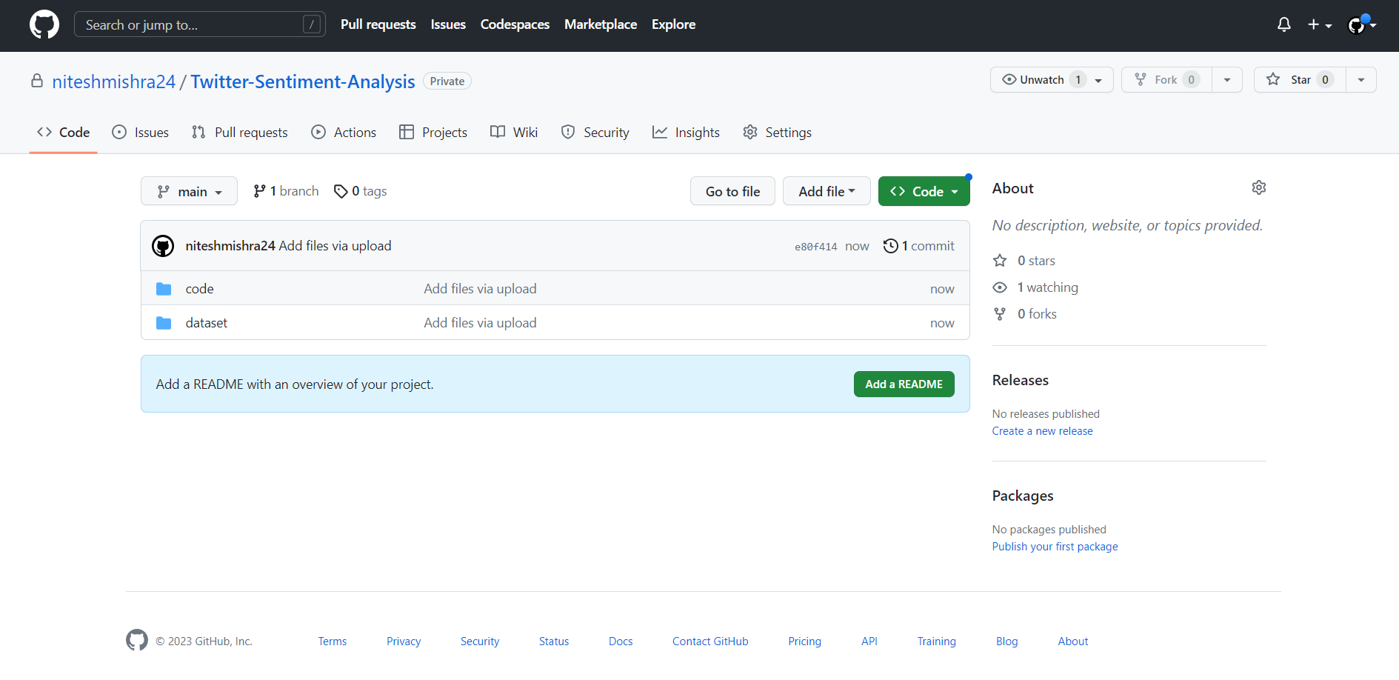
GitHub
Github Link : https://github.com/niteshmishra24/Twitter-Sentiment-Analysis

Slide 30
References
1. Rosenthal, Sara, Noura Farra, and Preslav Nakov."SemEval-2017 task 4: Sentiment analysis in Twitter." Proceedings of the 11th International Workshop on Semantic Evaluation (SemEval-2017). 2017.
2. B. Liang, R. Yin, J. Du, L. Gui, Y. He, M. Yang, and R. Xu, ‘‘Embedding refinement framework for targeted aspect-based sentiment analysis,’’ IEEE Trans. Affect. Comput., early access, Apr. 6, 2021.
3. L. Yue, W. Chen, X. Li, W. Zuo, and M. Yin, ‘‘A survey of sentiment analysis in social media,’’ Knowl. Inf. Syst., vol. 60, no. 2, pp. 617–663, 2019.
4. F. Hemmatian and M. K. Sohrabi, ‘‘A survey on classification techniques for opinion mining and sentiment analysis,’’ Artif. Intell. Rev., vol. 52, no. 3, pp. 1495– 1545, Oct. 2019.
5. A. U. Rehman, A. K. Malik, B. Raza, and W. Ali, ‘‘A hybrid CNN-LSTM model for improving accuracy of movie reviews sentiment analysis,’’ Multimedia Tools Appl., vol. 78, no. 18, pp. 26597–26613, Sep.2019.
6. A. P. Lenton-Brym, V. A. Santiago, B. K. Fredborg, and M. M. Antony, ‘‘Associations between social anxiety, depression, and use of mobile dating applications,’’ Cyberpsychol., Behav., Social Netw., vol. 24, no. 2, pp. 86–93, Feb. 2021.
7. K. Sailunaz and R. Alhajj, ‘‘Emotion and sentiment analysis from Twitter text,’’ J. Comput. Sci., vol. 36, Sep. 2019, Art. no. 101003.
8. Y. Kirelli and S. Arslankaya, ‘‘Sentiment analysis of shared tweets on global warming on Twitter with data mining methods: A case study on Turkish language,’’ Comput. Intell. Neurosci., vol. 2020, pp. 1904172:1–1904172:9, Sep.
9. A. Kumar and A. Jaiswal, ‘‘Systematic literature review of sentiment analysis on Twitter using soft computing techniques,’’ Concurrency Comput., Pract. Exp., vol. 32, no. 1, Jan. 2020, Art. no. e5107.
10. F. Z. Kermani, F. Sadeghi, and E. Eslami, ‘‘Solving the Twitter sentiment analysis problem based on a machine learning-based approach,’’ Evol. Intell., vol. 13, no. 3, pp. 381–398, 2020

Slide 31
11. Pontiki, Maria, et al. "SemEval-2016 task 5: Aspect based sentiment analysis." ProWorkshop on Semantic Evaluation (SemEval-2016). Association for Computational Linguistics, 2016.
12. Ahmed, Khaled, Neamat El Tazi, and Ahmad Hany Hossny. "Sentiment Analysis over Social Networks: An Overview." Systems, Man, and Cybernetics (SMC), 2015 IEEE International Conference on. IEEE, 2015.
13. Fang, Xing, and Justin Zhan. "Sentiment analysis using product review data." Journal of Big Data 2.1 (2015).
14. Go, A., Bhayani, R., & Huang, L. (2009). Twitter sentiment classification using distant supervision. CS224N Project Report, Stanford, 1(12), 2009.
15. Pak, A., & Paroubek, P. (2010). Twitter as a corpus for sentiment analysis and opinion mining. Proceedings of the Seventh Conference on International Language Resources and Evaluation (LREC'10), 1320-1326.
16. Agarwal, A., Xie, B., Vovsha, I., Rambow, O., & Passonneau, R. (2011). Sentiment analysis of Twitter data. Proceedings of the Workshop on Languages in Social Media, 30-38.
17. Smailović, J., Grčar, M., Lavrač, N., & Žnidaršič, M. (2013). Sentiment analysis on Twitter. Journal of Information and Organizational Sciences, 37(1), 25-40.
18. Wang, G., & Xie, Y. (2016). A comparative study of sentiment analysis methods on Twitter. Journal of Information Science, 42(5), 699-714.
19. Shrivastava, S., & Singh, S. (2018). Hybrid model for Twitter sentiment analysis. Proceedings of the International Conference on Computing, Communication and Automation (ICCCA), 1-6.
20. Chen, Y., & Skiena, S. (2014). Building sentiment classifiers for all languages. Proceedings of the Eighth International Conference on Language Resources and Evaluation (LREC'14), 4236-4242.

Slide 32
Thank You

